Slide 1
LaunchCode Liftoff Final Project
Jose Urdaneta

Slide 2
Agenda
Overview and project goals
Project Features
Technologies used
Code metrics
Live demo
Conclusions

Slide 3
Overview and project goals
Overview:
Web site for small to medium schools for the administration and control of evaluation plans and student grading.
This web application allows teachers to entry, save, modify and review the evaluation schedules for their assigned subjects and to grade the students according to the evaluation plans.
Students are able to see their grades using this web app.
A special user, the registrar, is able to entry data about hired teachers and to make the enrollment of students.
Goals:
The main goal for the development of this web application was to gain new knowledge about several technologies and plunge deeper in the Spring Boot framework.

Slide 4
Project features
There are (3) different kinds of users: students, teachers and registrars.
There is a user registration to the web site (except for registrars who are registered by the web app administrator).
Data visualization for students.
Data entry and visualization for teachers and registrars.
It’s a basic CRUD web application with a thin layer of business rules hard coded in the app itself.

Slide 5
Technologies used
Java
Spring Boot, Thymeleaf and JPA
HTML, CSS, Bootstrap
MySQL
JavaScript
IntelliJ IDEA
VSCode
MySQL Workbench
Git, GitHub, Stack Overflow, W3Schools, Baeldung and 100 more…

Slide 6
Code metrics
(6) packages
(48) classes
(1666) lines of Java code and about (500) lines of JavaScript
(4) Web and (1) Rest controller classes.
Using the CODEMR plugin for IntelliJ

Slide 7
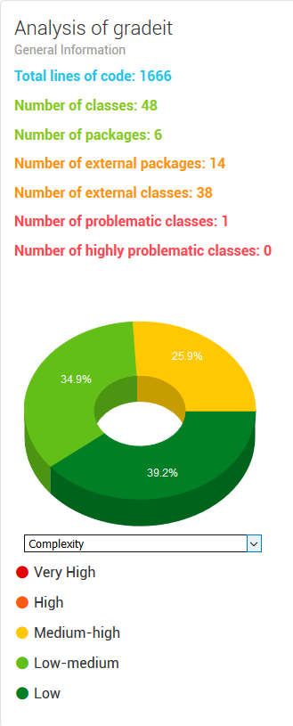
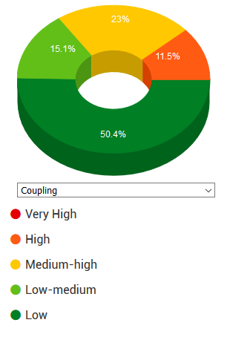
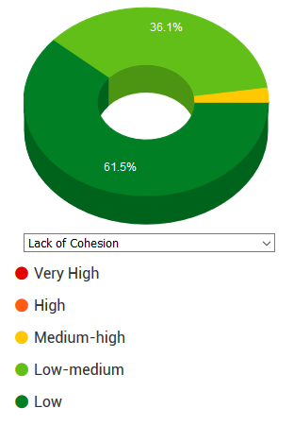
CODEMR metrics

Slide 8
Conclusions
This project took about 120 hours of development, of which probably 80% of the time was dedicated to conceptualization and learning. The rest of time was spent for coding, testing and debugging.
From the prospective of learning, I ended with a better understanding of the Spring Framework, JPA and Thymeleaf; I learned a new language (JavaScript) and I got my hands dirty with things like DOM, RESTful API development.
I’m very pleased to say that the main goal was fully accomplished and I finished more confident about what I would be able to achieve in the future.

